Slide 1
The role of abstraction in compositionality in human and artificial neural networks

Slide 2
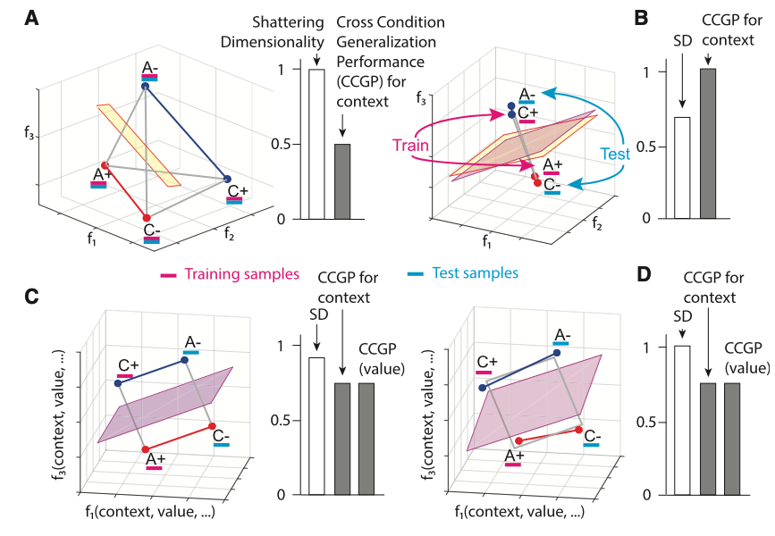
What internal representations are useful for compositional generalization?
Shattering dimensionality versus generalizability/abstraction
High shattering dimensionality –> not ideal for generalizability to new contexts

Slide 3
How are compositional representations in the human brain formatted?
High shattering dimensionality vs. abstract format?
Previous work has shown:
Compositional codes in human prefrontal cortex (Reverberi et al. 2012)
Abstract codes in non-human primate prefrontal cortex and hippocampus (Bernardi et al. 2020)
Little work has focused on:
Geometric format of compositional codes in humans and their importance
Our objective:
We characterize the geometric format of compositional codes in humans
Demonstrate their utility for compositional generalization in ANNs

Slide 4
Main questions
Do humans represent task information abstractly?
What are the benefits of compositional and abstract representations?
Hypothesis: Compositional behaviors benefit from abstract and generalizable representations in both humans and ANNs
Specific approach:
Characterize the geometric format (degree of abstractedness) in human fMRI data during a compositional task
Identify whether or not these ‘abstract formats’ emerge when an ANN is forced to learn compositionally
Characterize (and illustrate) the computational benefits of these abstract representations in models

Slide 5
General outline of results
Empirical human results
Evidence of compositionality in human behavior
Evidence of abstraction and compositional representations in whole-brain human imaging
2. ANN modeling results
Evidence of abstract representations when ANNs are forced to learn compositionally (pretraining on primitive tasks)
Evidence of systematic, zero-shot generalizability with compositional abstraction
3. Current/future work (?)
Optimizing models for compositional, abstracted, and clustered internal representations to facilitate efficient learning and generalizability in compositional tasks

Slide 6
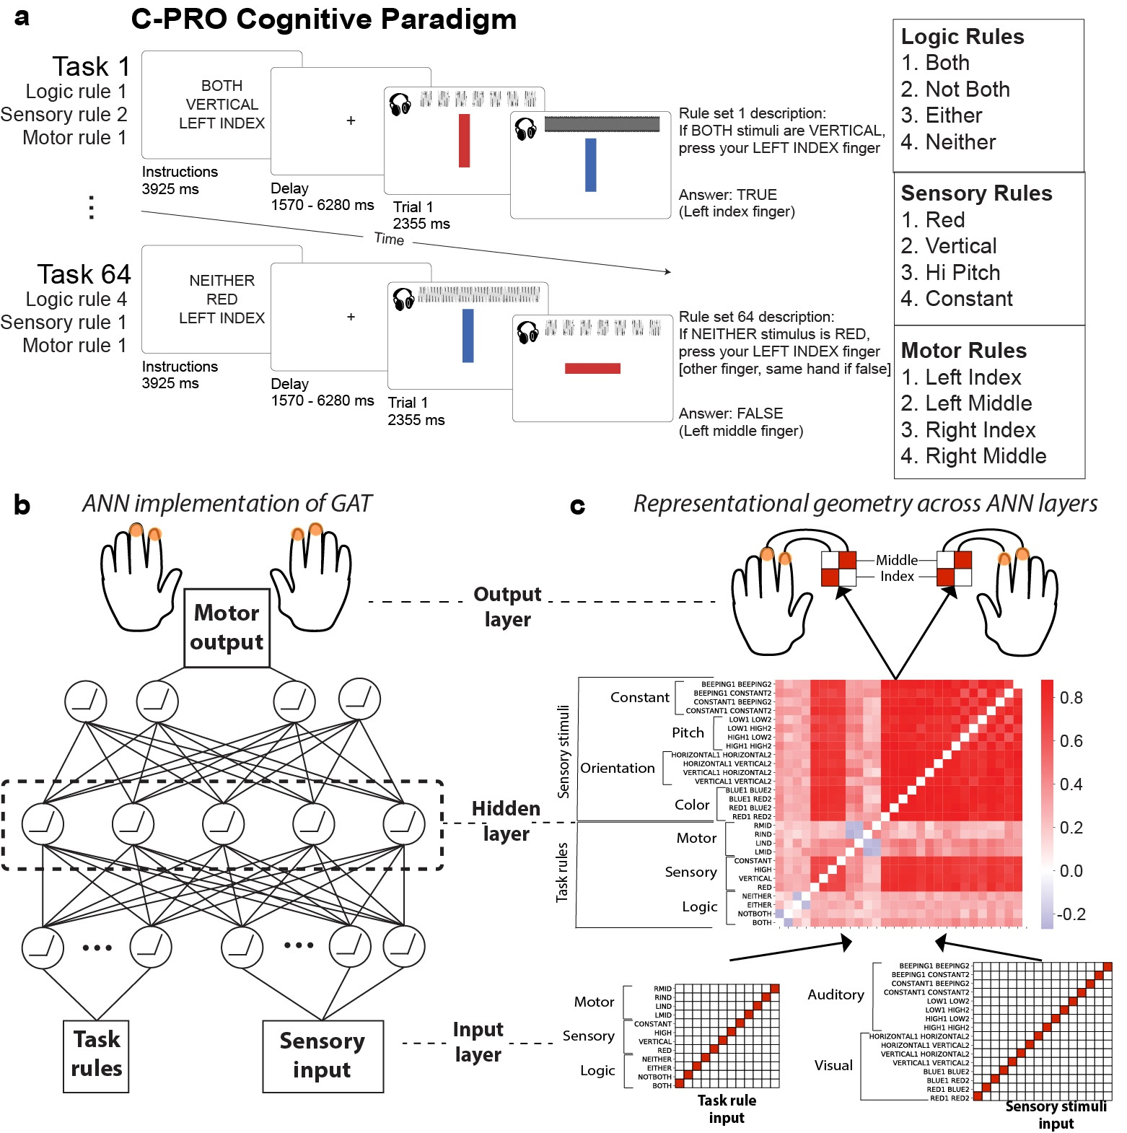
Task – Concrete Permuted Rule Operations (C-PRO)

Slide 7
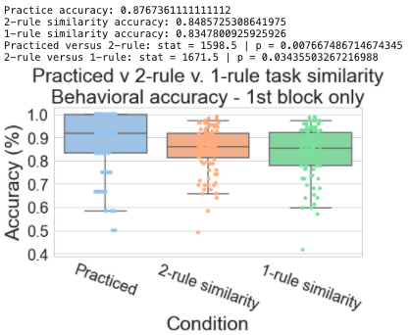
Evidence for compositionality in human behavior
The average performance of all 64 unique tasks (1st trial only)
Practiced tasks had highest performance
Tasks with more overlapping rules with practiced task had marginally higher task performances
Performance reflects likely compositional reasoning in human behavior

Slide 8
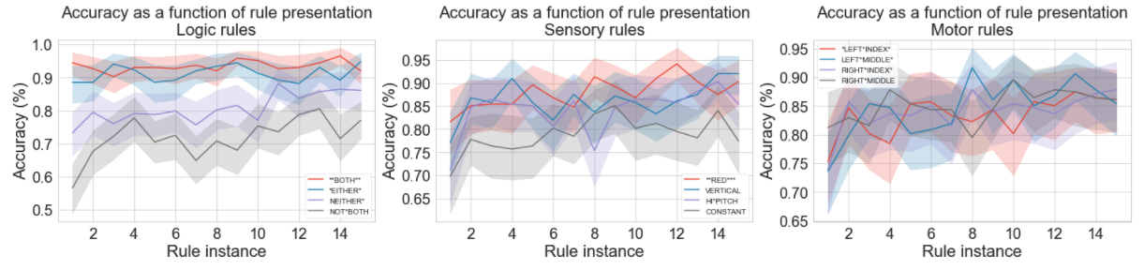
Evidence for compositionality in human behavior
For each rule, we track the performance of new tasks that include previously viewed task rules
Performance increases as a function of task rule viewings (despite being used in a new context), suggesting compositional learning and re-use of task rules

Slide 9
General outline of results
Empirical human results
Evidence of compositionality in human behavior
Evidence of abstraction and compositional representations in whole-brain human imaging
2. ANN modeling results
Evidence of abstract representations when ANNs are forced to learn compositionally (pretraining on primitive tasks)
Evidence of systematic, zero-shot generalizability with compositional abstraction
3. Current/future work (?)
Optimizing models for compositional, abstracted, and clustered internal representations to facilitate efficient learning and generalizability in compositional tasks

Slide 10
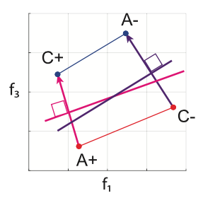
How do we measure abstraction and compositionality in neural data?
Calculating the parallelism score (PS)
If we’re interested in seeing how generalizable a decoder for context (i.e., the blue dots) are, we evaluate the similarity of angles between decoders
So, we can compare the cosine (dot product) between the purple and pink vectors
Bernardi et al. (2020) Cell

Slide 11
Measure abstractedness using parallelism score
BOTH
RED
LMID
BOTH
VERTICAL
RMID
a₂
b₂
A
B
a₁
b₁
EITHER
RED
LMID
EITHER
VERTICAL
RMID
Objective: Compute the angle between A and B, where
A = a₂ – a₁
PS = mean {||A|| • ||B||}
for every possible BOTH v. EITHER combination
B = b₂ – b₁

Slide 12
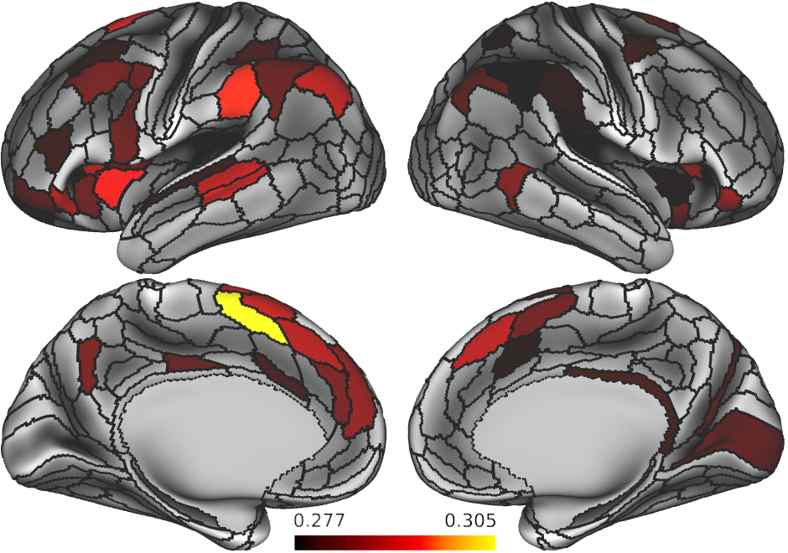
Logic rule CCGP – statistical significance assessed using alpha=0.05 on shuffled data

Slide 13
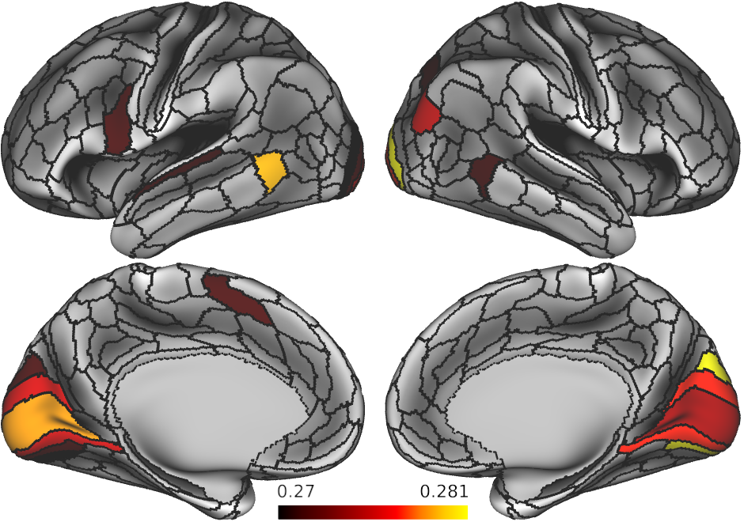
Sensory rule CCGP – statistical significance assessed using alpha=0.05 on shuffled data

Slide 14
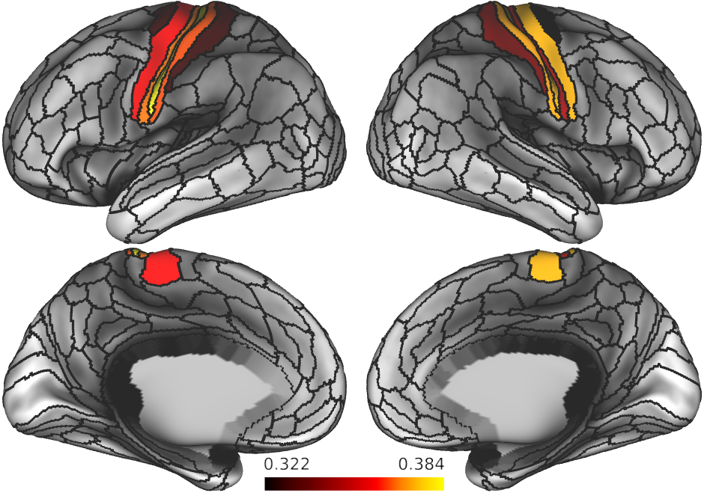
Motor rule decoding – statistical significance assessed using alpha<0.05 on shuffled data

Slide 15
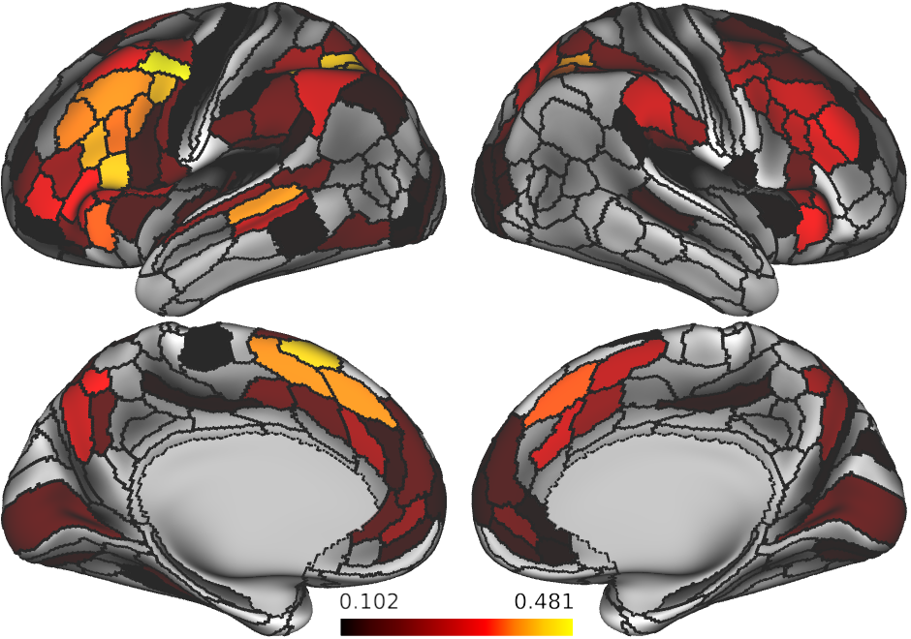
Logic rule parallelism – statistical significance assessed using alpha=0.05 on shuffled data
Abstract representations for logic rules are lie mostly in frontoparietal ”task positive regions”

Slide 16
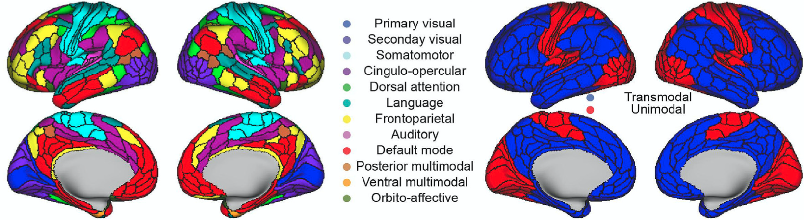
Reference of what functional networks organization in the human brain

Slide 17
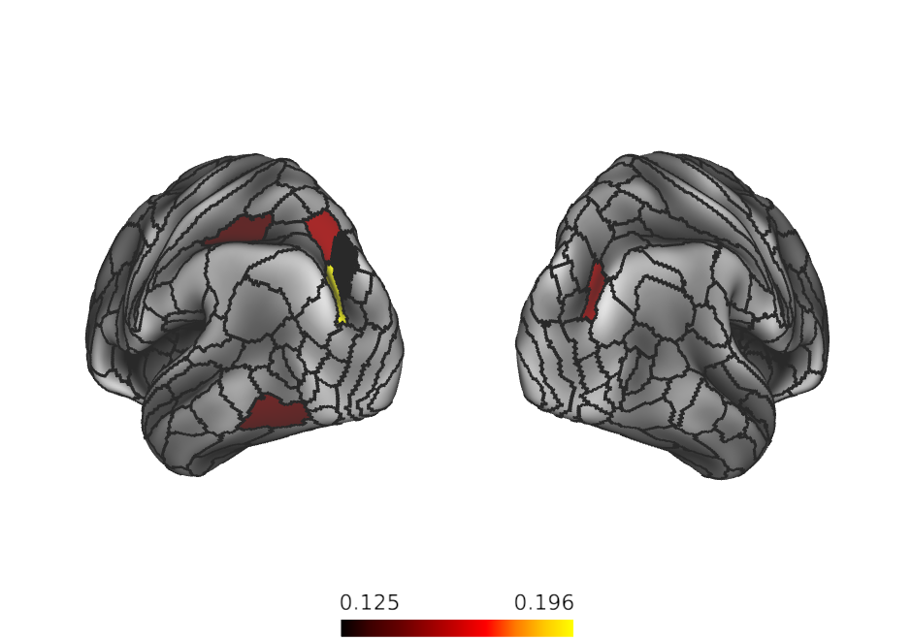
Sensory rule parallelism – statistical significance assessed using alpha<0.05 on shuffled data
Abstract representations for sensory rules are lie mostly in higher order visual areas and some dorsal attention network regions

Slide 18
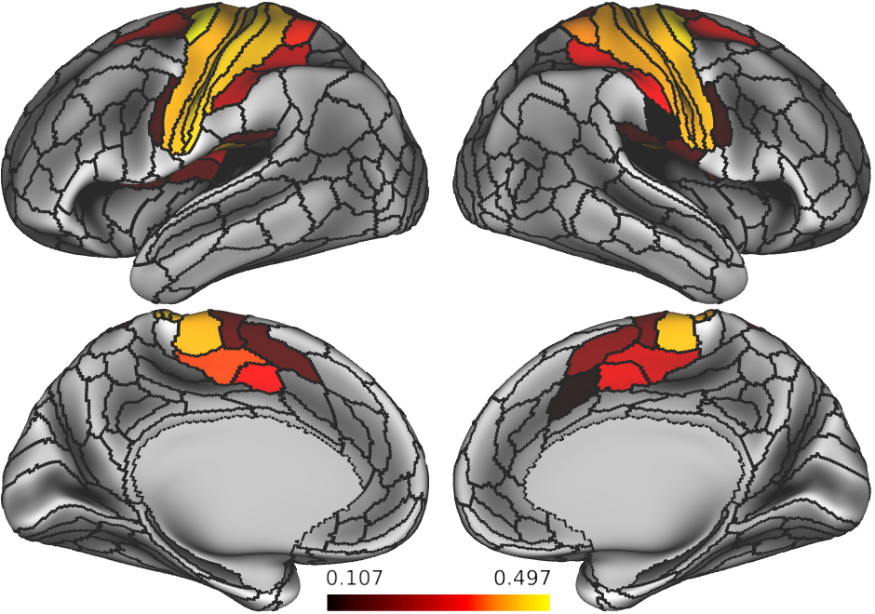
Motor rule parallelism – statistical significance assessed using alpha<0.05 on shuffled data
Abstract representations for motor rules are mostly lie in higher order visual areas and some dorsal attention network regions

Slide 19
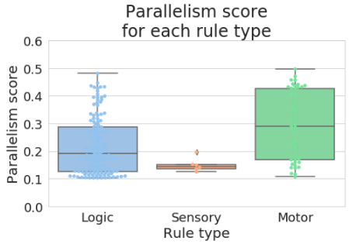
How about the overall degree of parallelism per rule domain?
Sensory rules appears to have an intrinsically lower parallelism score relative to other rule domains
Is this due to the data, or a function of the task?

Slide 20
General outline of results
Empirical human results
Evidence of compositionality in human behavior
Evidence of abstraction and compositional representations in whole-brain human imaging
2. ANN modeling results
Evidence of abstract representations when ANNs are forced to learn compositionally (pretraining on primitive tasks)
Evidence of systematic, zero-shot generalizability with compositional abstraction
3. Current/future work (?)
Optimizing models for compositional, abstracted, and clustered internal representations to facilitate efficient learning and generalizability in compositional tasks

Slide 21
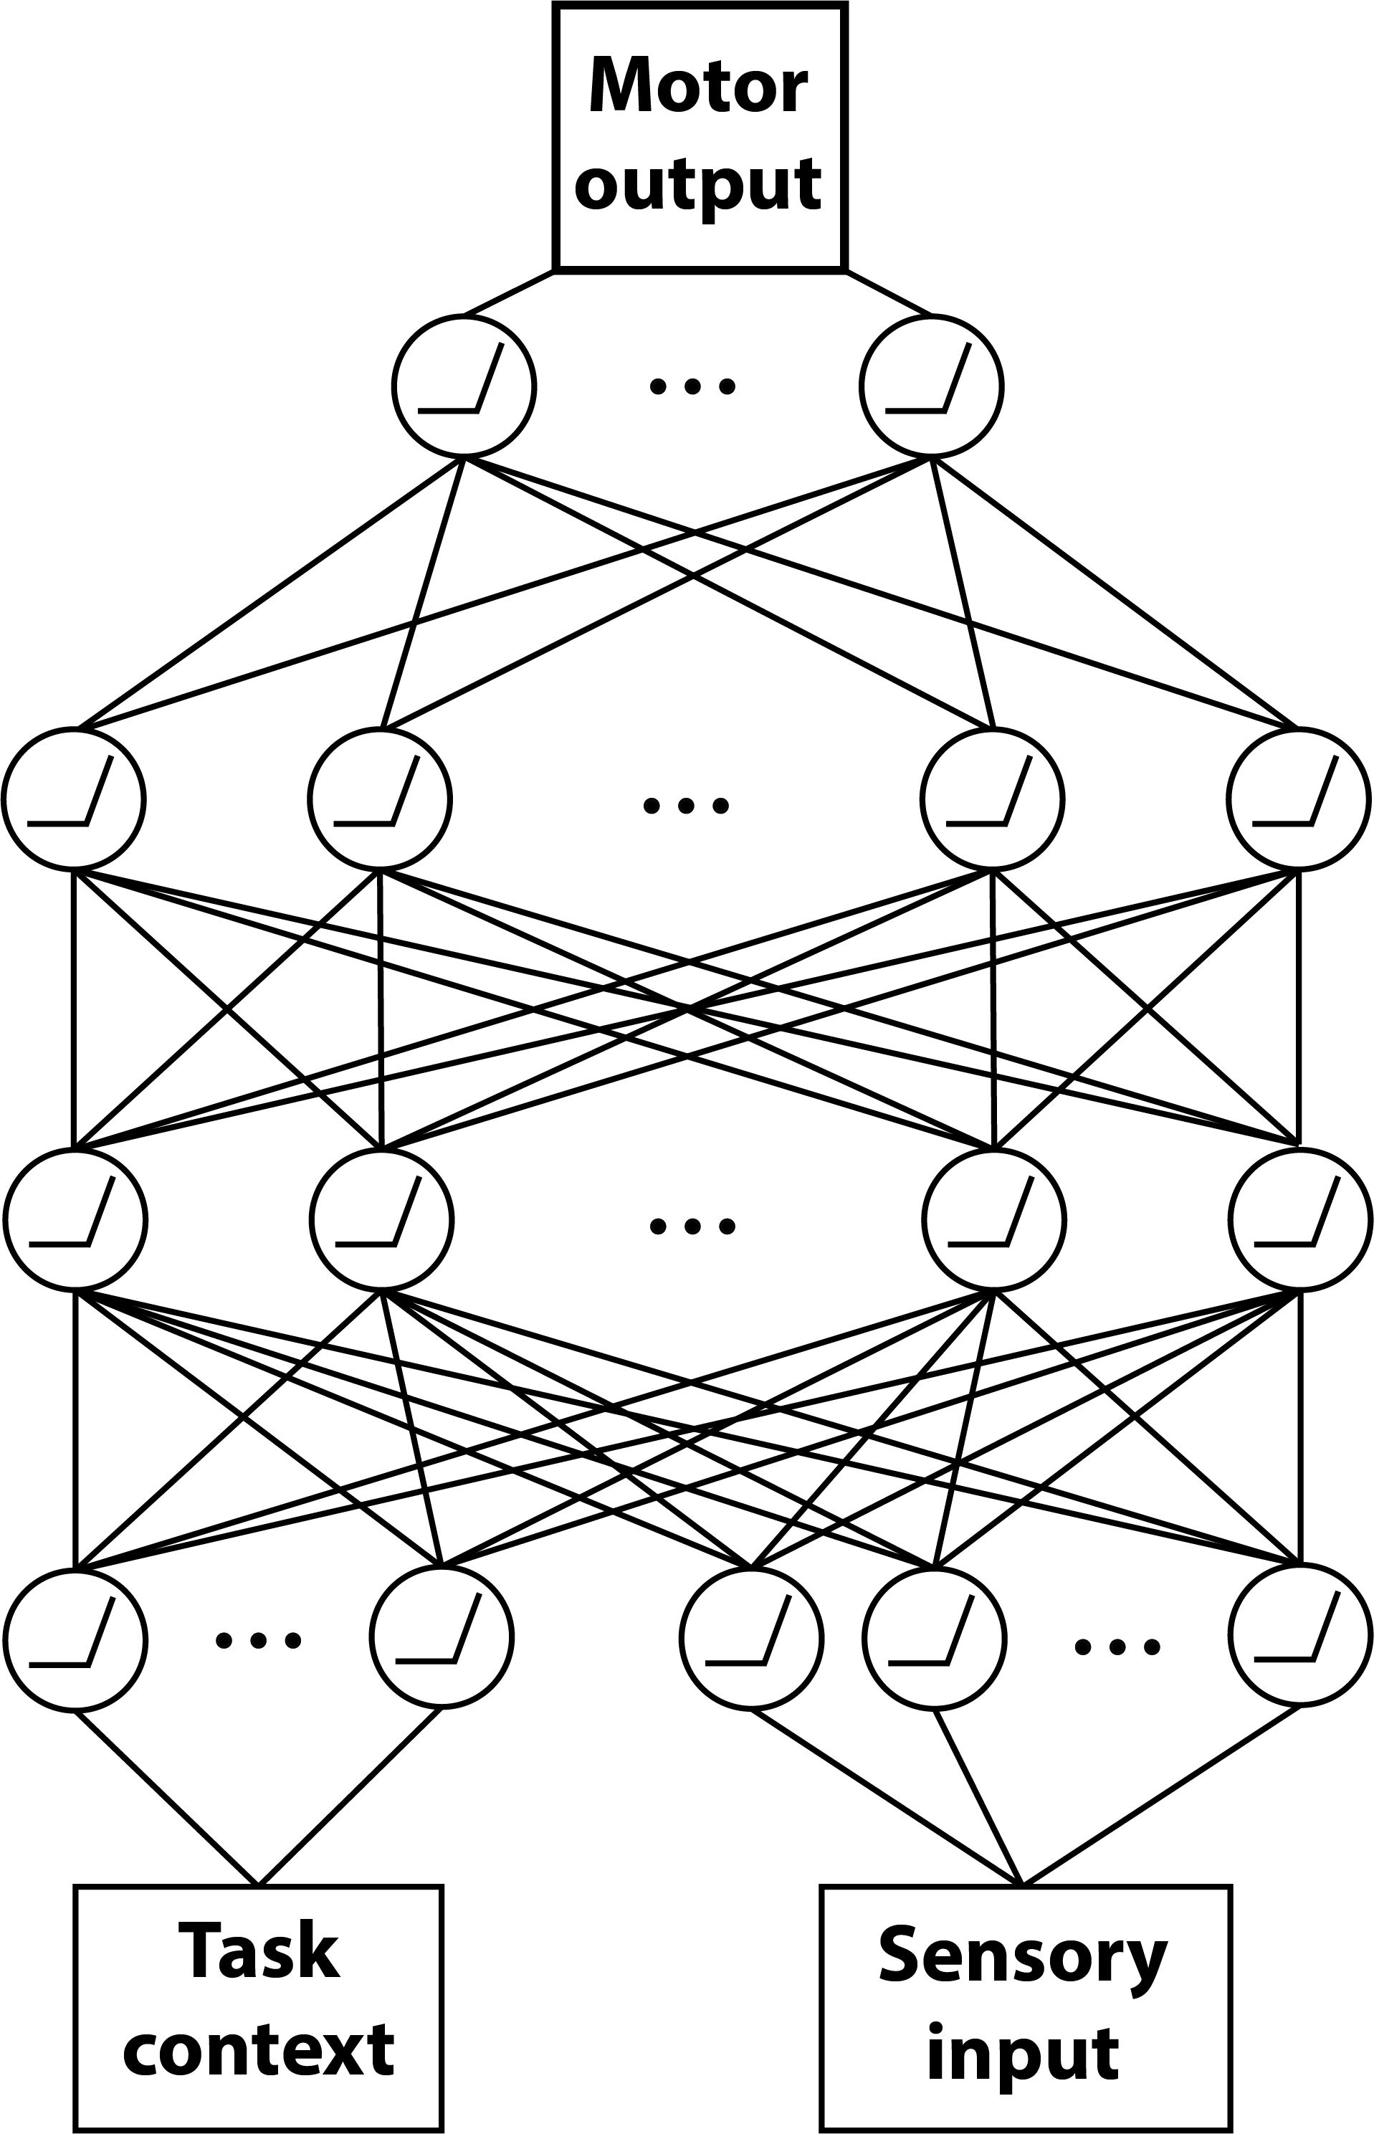
Model architecture – simple feedforward network
4 units
256 units
256 units
11 (context) + 16 (sensory) units

Slide 22
Analysis 1 – Force an ANN to learn compositionally through training on primitive tasks
Build a model to perform the C-PRO task
Evaluate compositional behavior on a network trained on 4 tasks with pretraining (on compositional primitives) and without
Does the ANN exhibit similar compositional behaviors to humans?

Slide 23
Analysis 1 – ANN pretraining approach
Two simplified tasks:
Sensorimotor task:
If RED press LEFT MIDDLE
If VERTICAL press RIGHT INDEX
Logical-sensory tasks
If BOTH RED -> TRUE/FALSE
If NEITHER VERTICAL -> TRUE/FALSE
For both networks: Train on 4 practiced tasks (like human experiment)

Slide 24
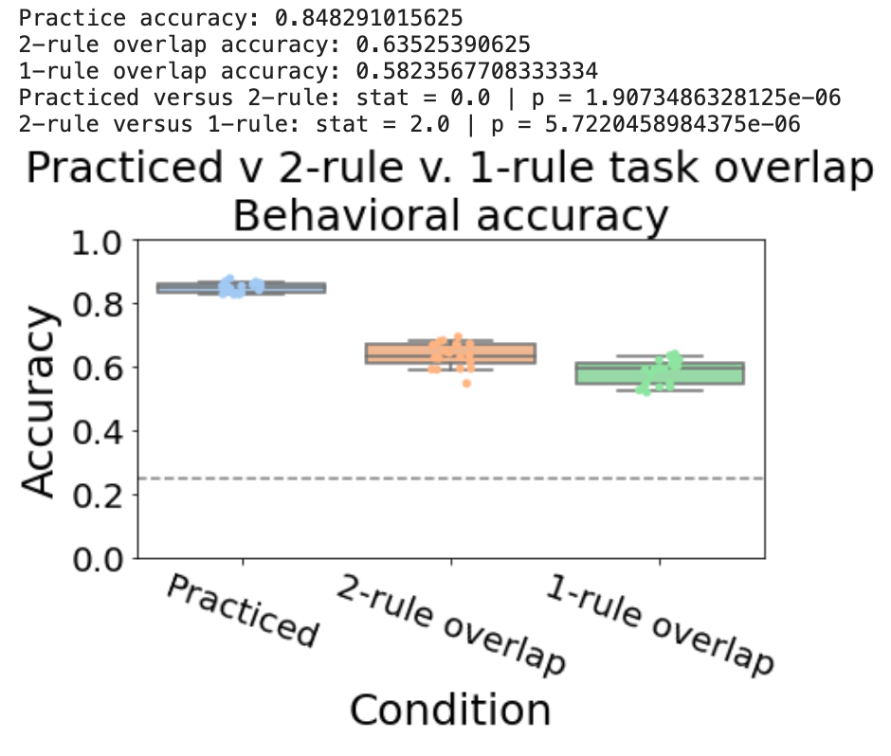
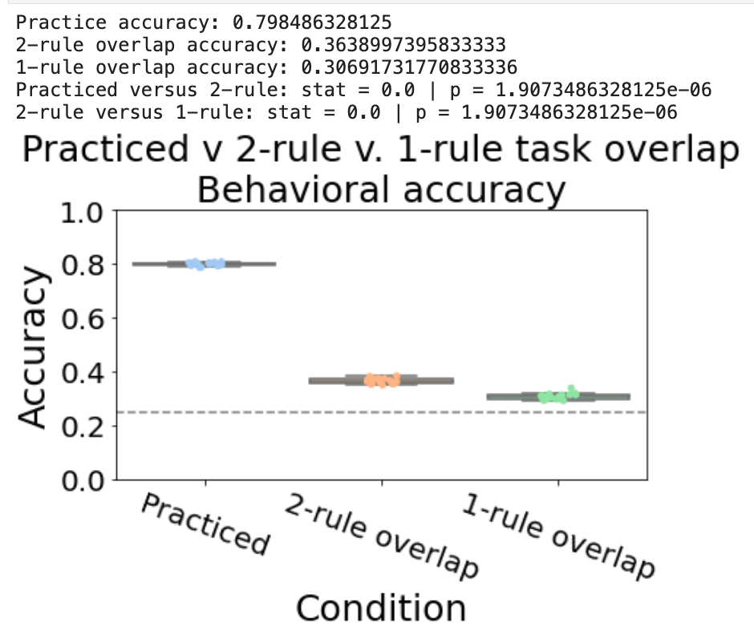
Accuracy significantly improves with pretraining on primitive tasks

Slide 25
Networks without pretraining cannot generalize and learn new tasks

Slide 26
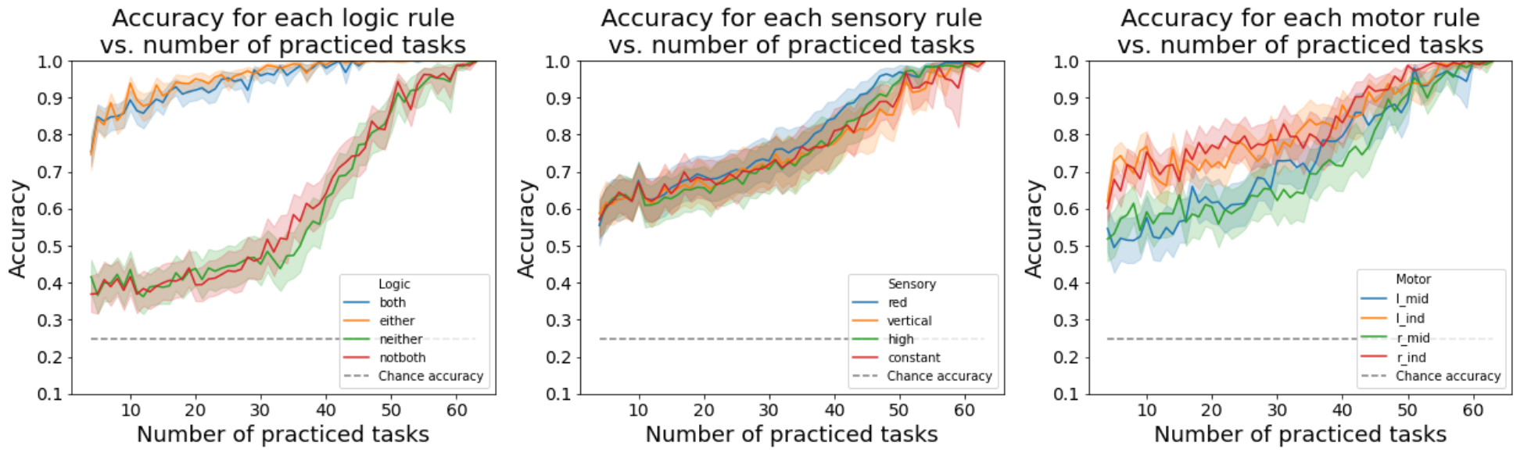
ANN equivalent of by-rule analysis – Adam x pretraining
“both” and ”either” are significantly easier than ”notboth” and “neither”

Slide 27
Why are ANNs biased towards affirmative (BOTH & EITHER) rules, rather than negative rules?
Hypothesis – Questions that we pose are inherently biased towards affirmative conditionals
Ex: If RED then press RMID
Observation: Questions can be inherently biased towards negative conditionals, too
Ex: If NOT RED, then press RMID
Hypothesis: Train network only on negative conditionals in the sensorimotor primitive task

Slide 28
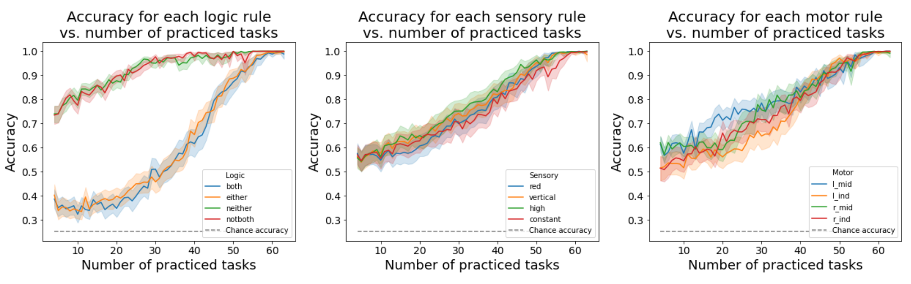
Training on negations only
Performance on specific logical rules is flipped – rules involving negations outperform ‘affirmative’ rules

Slide 29
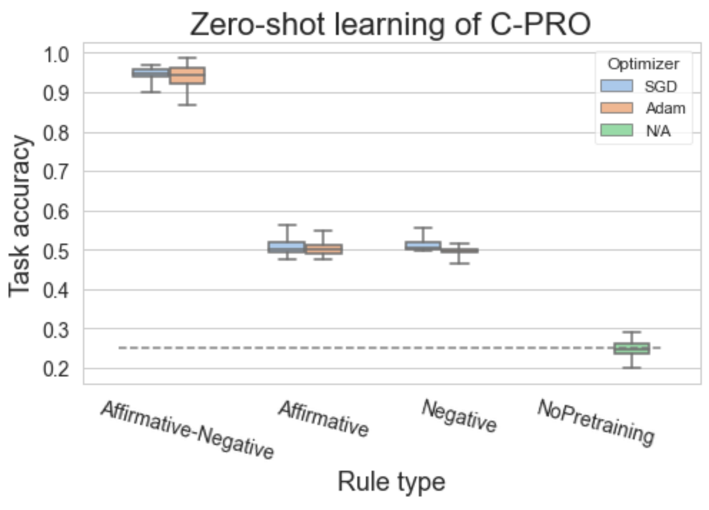
Training on negations and affirmative tasks equally
Equal training on both affirmative and negative versions of the primitive task enable zero-shot learning
Illustrates systematicity (ability to re-use rules)
Productivity (though only of depth 1)

Slide 30
ANNs exhibit compositional behavior when trained in a compositional way
Next: ANN representations

Slide 31
Parallelism as a function of # tasks trained
Higher parallelism -> higher the abstraction
Pretraining boosts parallelism

Slide 32
Parallelism by rule type
PS from empirical brain data
Gray distribution is the “null”
Domain specific abstraction in ANNs (with compositional training)
mimics abstraction in the brain

Slide 33
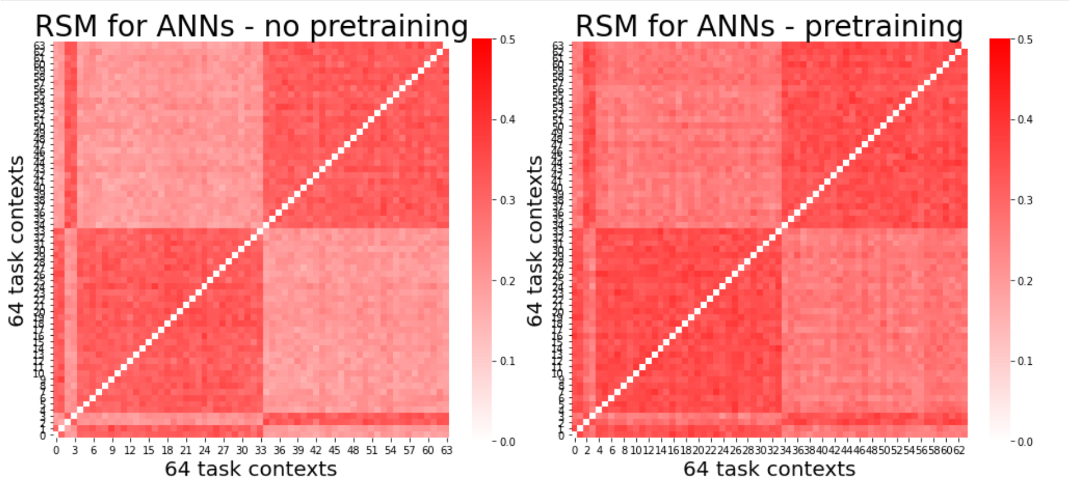
Do pretrained, compositional ANNs have more efficient (lower dimensional) representations?

Slide 34
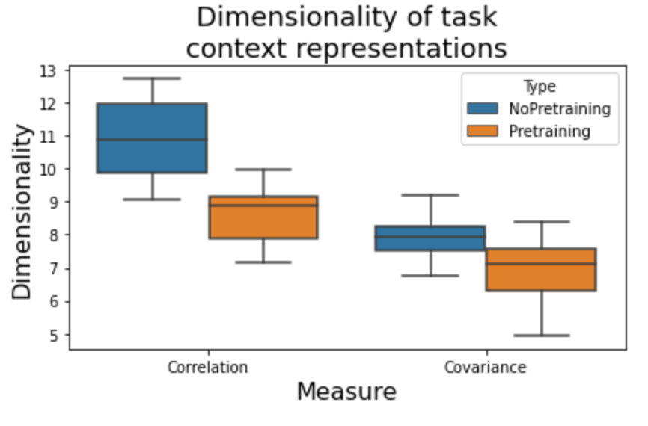
Pretraining of networks also results in reduced dimensionality, another form of abstraction
Dimensionality in the feature space

Slide 35
Summary of results
Humans exhibit compositionality in task performance between familiar and novel task types
Humans exhibit compositional brain representations as exhibited by parallelism scores across rule types
ANNs can exhibit compositionality, if pretrained with useful compositional primitives
This affords generalizability as evidenced by zero-shot learning
Abstract and efficient representations may underlie the ability to generalize in both humans and ANNs

Slide 36
Applications to AI (yet to be done)
Can we regularize task performance using different measures of abstraction?
Maximize parallelism in hidden units
Minimize dimensionality in hidden units

Slide 37
What is the benefit of compressed, lower dimensional representations of the task context?
Do compressed context representations influence behavioral representations?

Slide 38
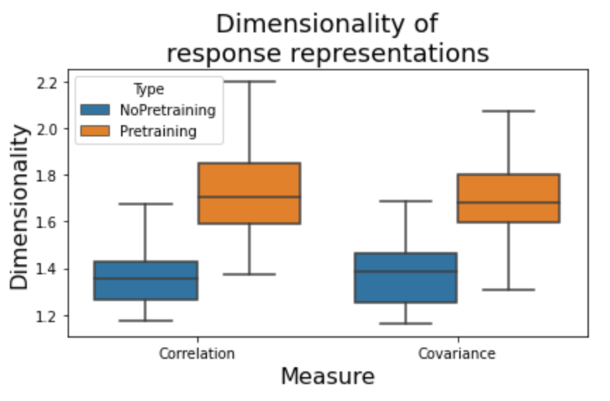
Do pretrained, compositional ANNs have higher dimensional behavioral representations (also have higher decoding accuracies)
Suggests abstract, compositional representations are useful for extracting relevant behavioral representations

Slide 39
Hypothesis / Prediction from model?
Makes 2 predictions: Increased compositionality leads to…
Improved behavioral representations for decoding
Lower dimensional context representations
Can be tested in empirical data by evaluating decodability of context and response (separately) as a function of rule presentation
*perhaps can serve as a hypothesis/explanation as to why PFC areas have such low decoding accuracies of context info

Slide 40
ANN experiment 2
Iteratively train networks on n practiced tasks, and test on 64 – n novel tasks
Tests for ‘one shot learning’
If networks are learning compositionally, they should likely improve performance as n increases
4 network types (all trained on 150 epochs)
ANN with pretraining (SGD)
ANN with pretraining (Adam)
ANN (SGD) – no pretraining
ANN (Adam) – no pretraining

Slide 41
Earlier hypothesis:
Lower dimensional task context representations
➔
Higher dimensional response representations
So, across training, does reduced context dimensionality correlate with response dimensionality?

Slide 42
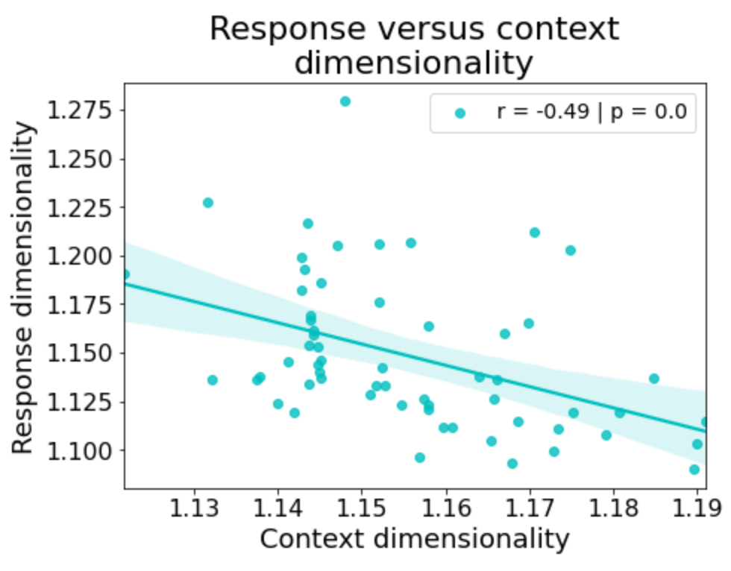
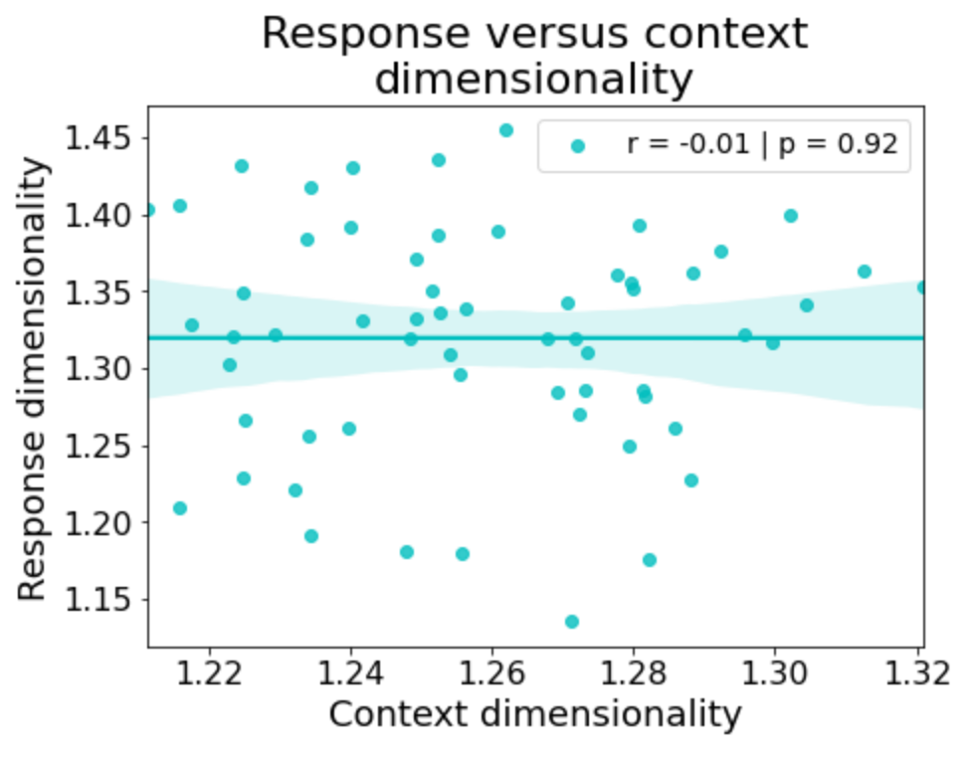
Adam + Pretraining
SGD + Pretraining
Unclear why there is this distinction… though Adam does train much more quickly/efficiently than SGD

Slide 43
Leads to a testable hypothesis in data:
Lower dimensional task context representations
➔
Higher dimensional response representations
In prefrontal areas
Can also evaluate how dimensionality is shaped across each presentation of a new rule

Slide 44
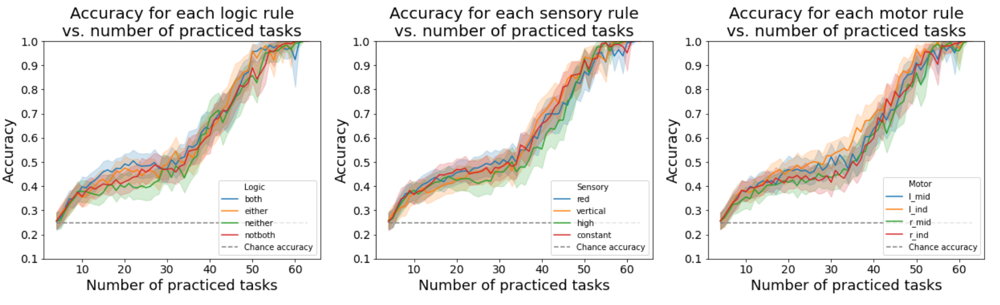
ANN equivalent of by-rule analysis – Adam x no pretraining
Without pretraining, you no longer see this distinction

Slide 45
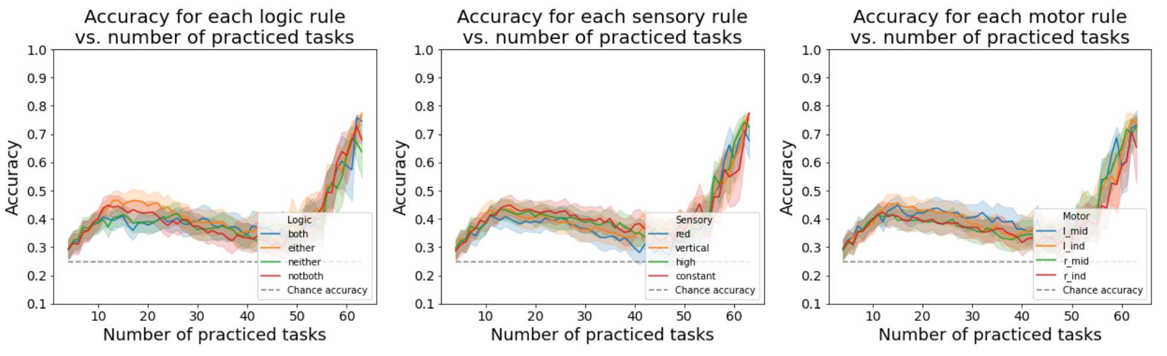
ANN equivalent of by-rule analysis – SGD x no pretraining
Without pretraining, you no longer see this distinction

Slide 46
How are the task rule inputs modeled?
both
either
not
red
vertical
high
constant
lmid
lind
rmid
rind
Logic
Sensory
Motor

Slide 47
How are simple/primitive tasks modeled? Logical-sensory primitive task
both
either
not
red
vertical
high
constant
lmid
lind
rmid
rind
Logic
Sensory
Motor
If EITHER stimulus is VERTICAL, output TRUE; else FALSE
both
either
not
red
vertical
high
constant
lmid
lind
rmid
rind
Logic
Sensory
Motor
If NEITHER stimulus is HIGH, output TRUE; else FALSE

Slide 48
How are simple/primitive tasks modeled? Sensorimotor primitive task
both
either
not
red
vertical
high
constant
lmid
lind
rmid
rind
Logic
Sensory
Motor
If stimulus is VERTICAL, output RMID; else RIND
both
either
not
red
vertical
high
constant
lmid
lind
rmid
rind
Logic
Sensory
Motor
If stimulus is HIGH, output RIND; else RMID

Slide 49
Why are ANNs biased towards affirmative (BOTH & EITHER) rules, rather than negative rules?
Hypothesis – Questions that we pose are inherently biased towards affirmative conditionals
Ex: If RED then press RMID
Observation: Questions can be inherently biased towards negative conditionals, too
Ex: If NOT RED, then press RMID
Hypothesis: Train network only on negative conditionals in the sensorimotor primitive task

Slide 50
Converting affirmative conditionals to negative conditionals in the sensorimotor primitive task
both
either
not
red
vertical
high
constant
lmid
lind
rmid
rind
Logic
Sensory
Motor
If stimulus is NOT VERTICAL, output RMID; else RIND
both
either
not
red
vertical
high
constant
lmid
lind
rmid
rind
Logic
Sensory
Motor
If stimulus is NOT HIGH, output RIND; else RMID

Slide 51
Evaluating task performance by specific rules
Performance on specific logical rules is flipped – rules involving negations outperform ‘affirmative’ rules

Slide 52
What if we pretrained the networks on both affirmative and negative versions of the sensorimotor primitive task?

Slide 53
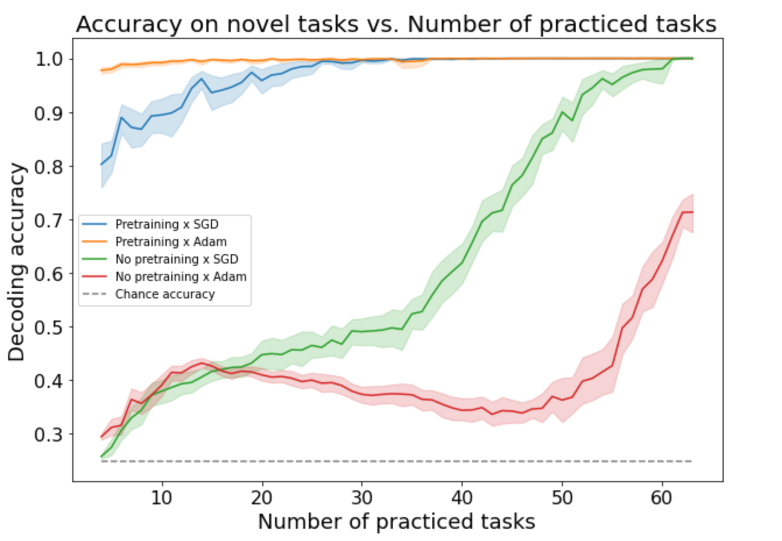
Training on both affirmative + negative sensorimotor primitive tasks yields nearly perfect performance after training on just 4/64 tasks

Slide 54
What about zero-shot learning on the full C-PRO task?
Pretrained tasks have never seen all 3 rules together
Would be a demonstration of systematicity and productivity (extending 2 rule to 3 rule tasks)

Slide 55
Highly accurate zero-shot learning when training on both affirmative & negative sensorimotor primitive tasks

Slide 56
Same results if ‘not both’ and ’neither’ are encoded separately
both
either
not both
neither
red
vertical
high
constant
lmid
lind
rmid
rind
Logic
Sensory
Motor

Slide 57
Empirical fMRI results
Objective: identify how and where the brain represents compositional information
Previous work has shown that the brain contains compositional representations (Reverberi et al. 2012; Cole et al. 2015)
But what are the computational properties of compositional representations, and why are they useful?

Slide 58
Approach
Identify regions that are sensitive to compositional representations
Test for…
Regions sensitive to novelty (i.e., practiced versus novel tasks), since novelty-sensitive regions are likely involved in flexible re-use of compositions (Cole et al. 2016)
Regions that are sensitive to negations – within Logic rules, we can group NEITHER + NOT BOTH versus EITHER and BOTH
Cross condition generalization performance (CCGP) (Reverberi et al. 2012; Bernardi et al. 2020) – question for Mattia: CCGP with distance-based classification would suggest the clustering of representations?
Parallelism – the degree of ‘abstractedness’ in a brain region (Bernardi et al. 2020)

Slide 59
Novelty results
For each task block (which includes a single task context), label it as either ‘practiced’ or ‘novel’
Run a cross-subject decoding on novel and practiced blocks, testing on held-out subjects (10-fold)
Note that each subject has distinct practiced task contexts they are trained on

Slide 60
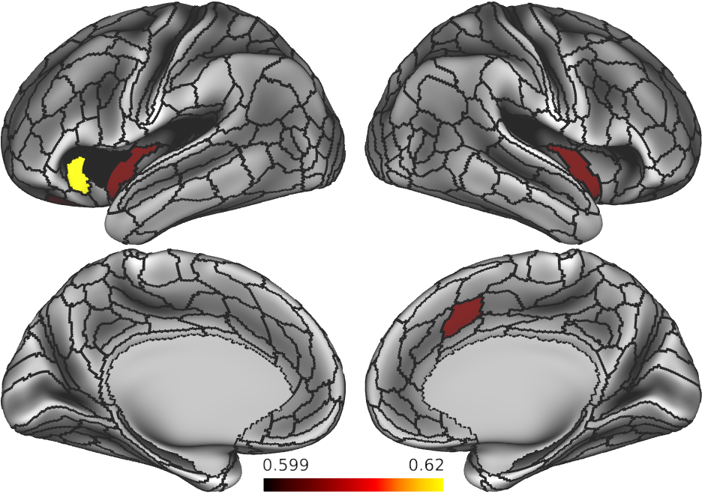
Regions sensitive to novelty?

Slide 61
Regions sensitive to negations
If a brain area represents information compositionally, it should be able to disentangle affirmative conditions (BOTH & EITHER) from negations (NOT BOTH & NEITHER)
This is another form of cross-condition generalization
Cross-subject 10-fold cross validation

Slide 62
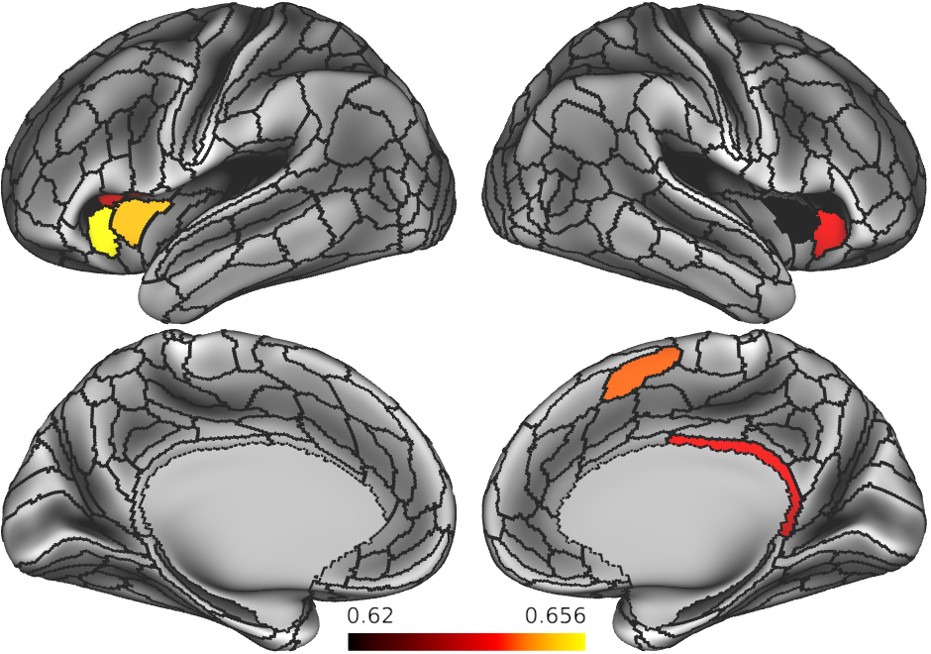
Regions sensitive to negations?

Slide 63
CCGP results
Extract 64 task contexts
For each rule domain decode logic rules (BOTH v EITHER v NOTBOTH v NEITHER)
By definition, since there’s only one sample per task context, this is CCG

Slide 64
Parallelism results
Extract 64 task contexts
For each rule domain compute the degree of parallelism between each pair of rules across contexts
Ex, to test compositionality and coding directions of BOTH and EITHER rules, test if the following 2 vectors are parallel
VECTOR1: BOTH – RED – LMID → EITHER – RED – LMID
VECTOR2: BOTH – VERTICAL – RMID → EITHER – VERTICAL – RMID

Slide 66
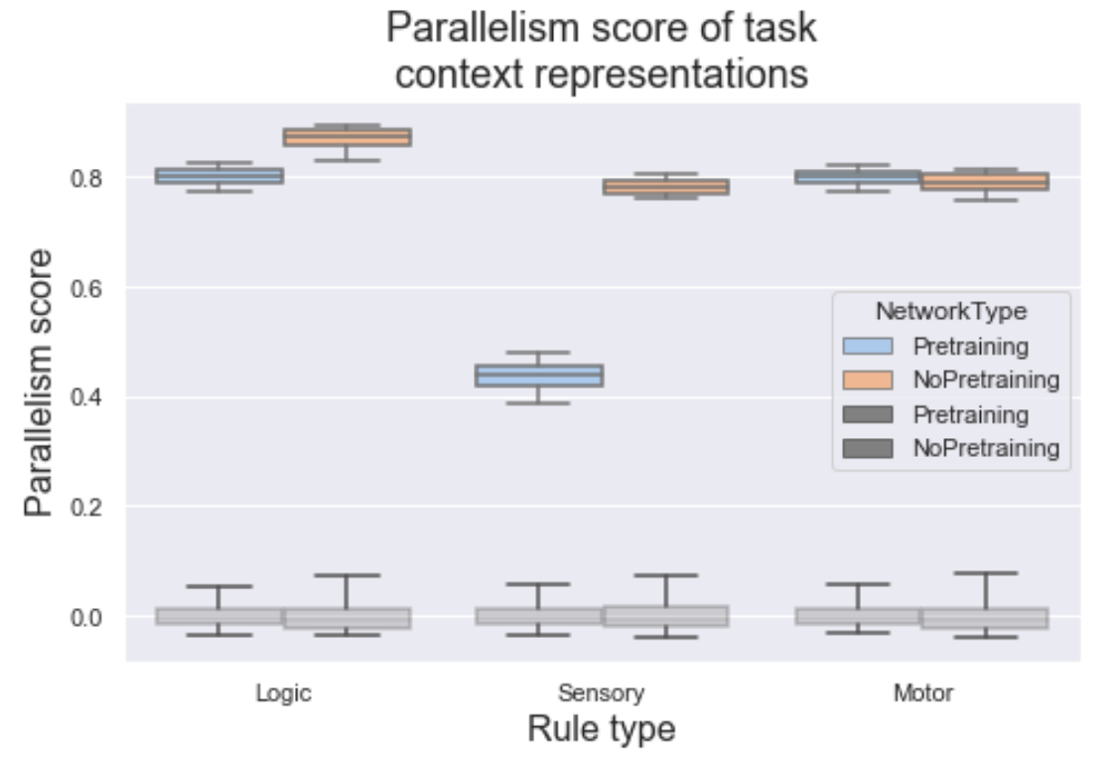
Measure abstractedness using parallelism score

Slide 67
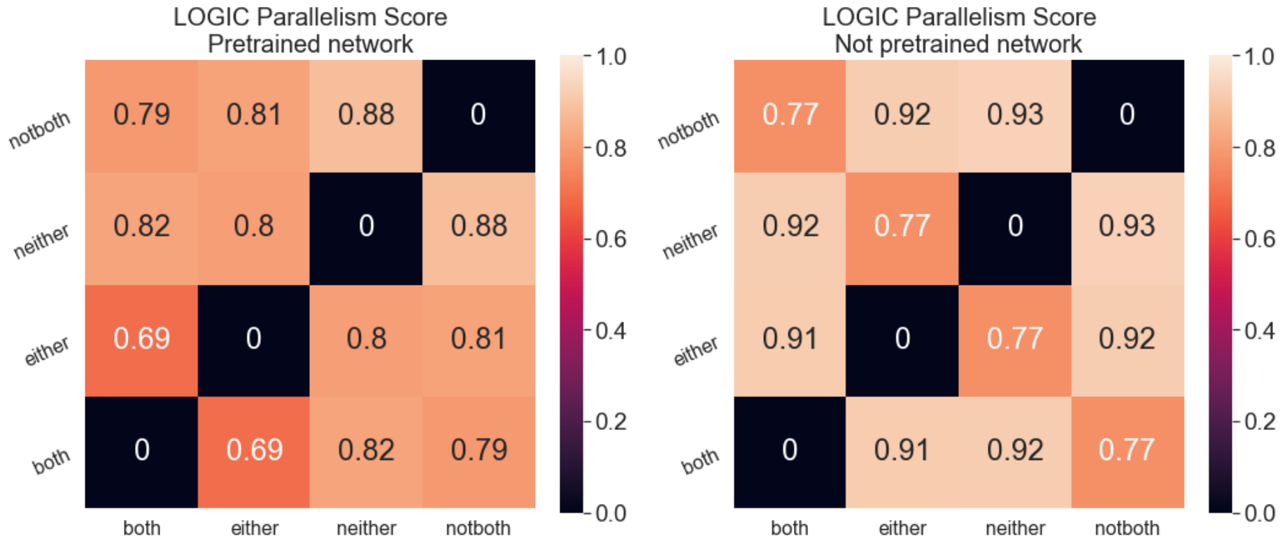
Logic specific cosine angles

Slide 68
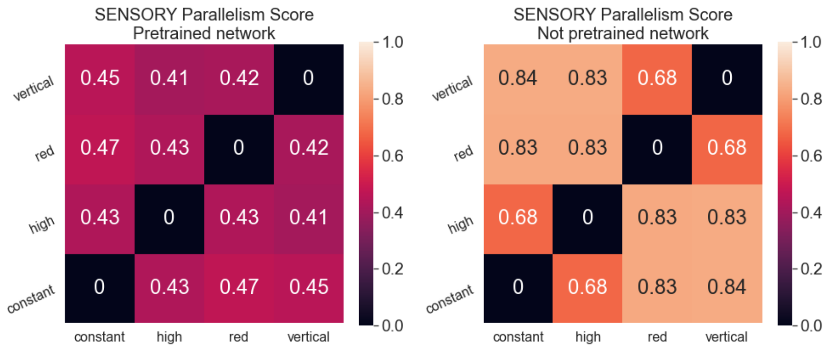
Sensory specific cosine angles

Slide 69
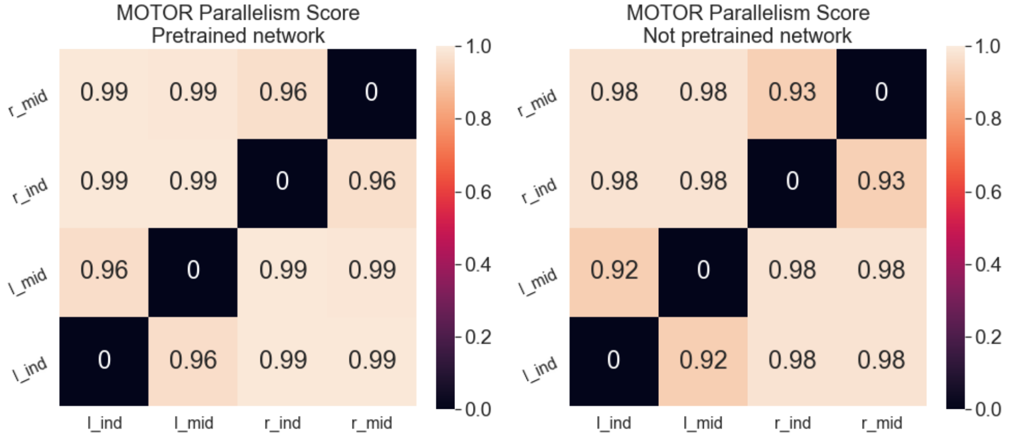
Motor specific cosine angles

Slide 70
Different set of figures from previous project

Slide 71
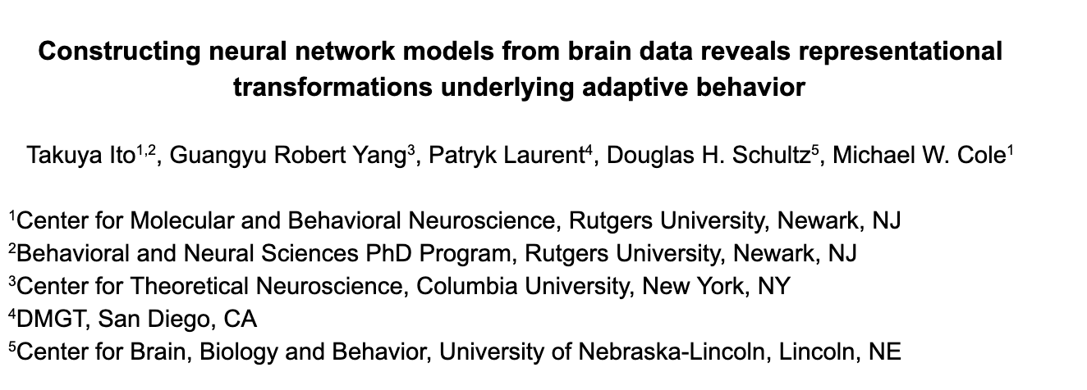
Constructing ANNs from neural data to perform a compositional task

Slide 72
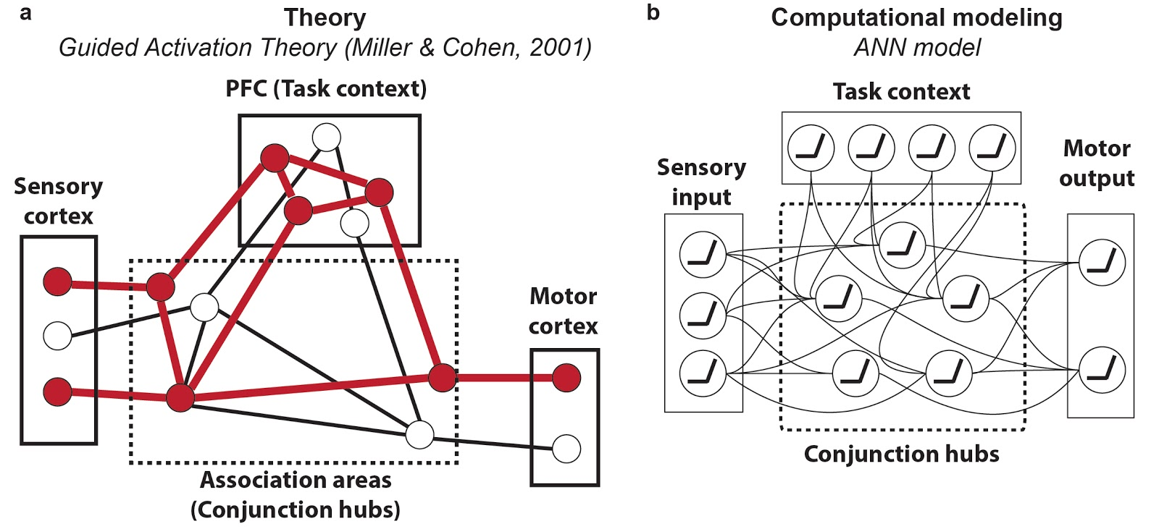
Using psychological theory and ANNs to inspire models of cognitive computations from data

Slide 73
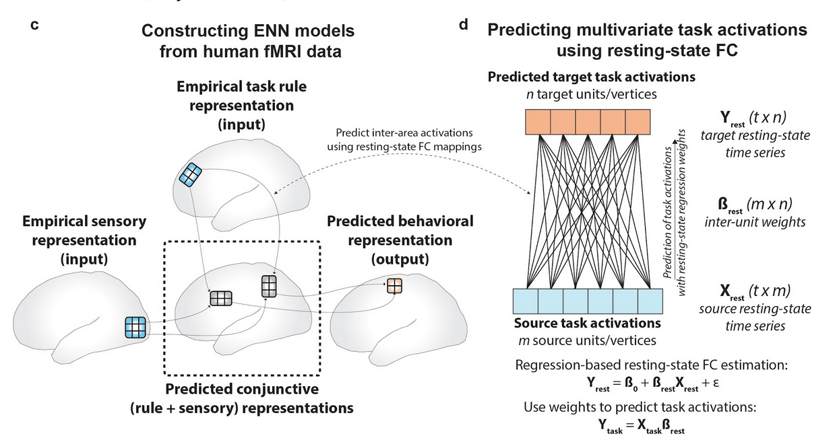
Constructing ENNs (empirical NNs) from data to characterize cognitive computations

Slide 74
Task – Concrete Permuted Rule Operations (C-PRO)

Slide 75
Identifying representational changes in ANNs to match to brain data

Slide 76
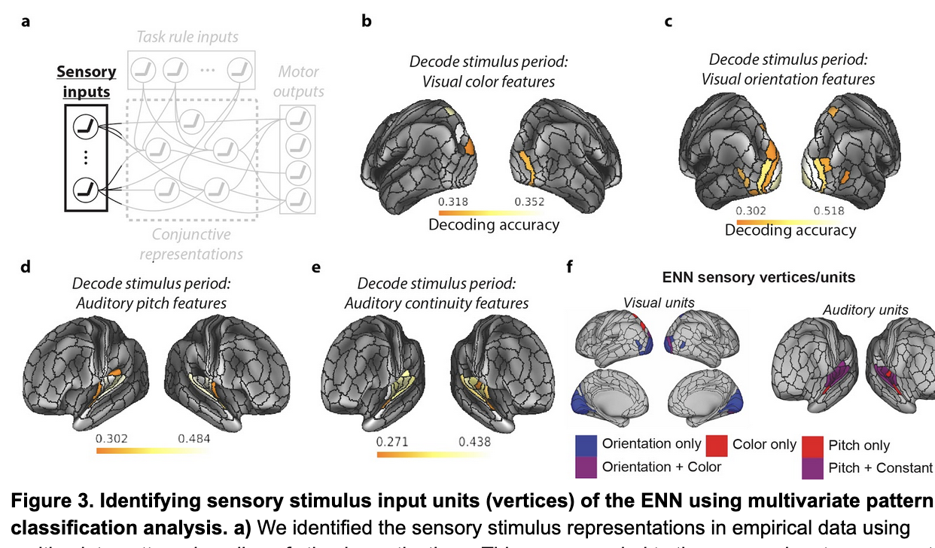
Identifying task-relevant brain areas: Sensory regions

Slide 77
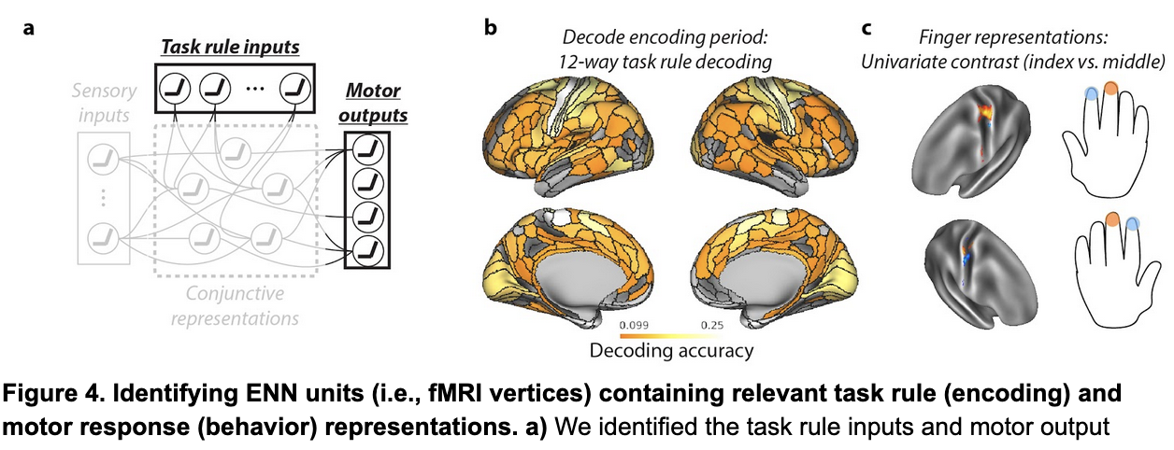
Identifying task-relevant brain areas: Rule-representing and motor regions

Slide 78
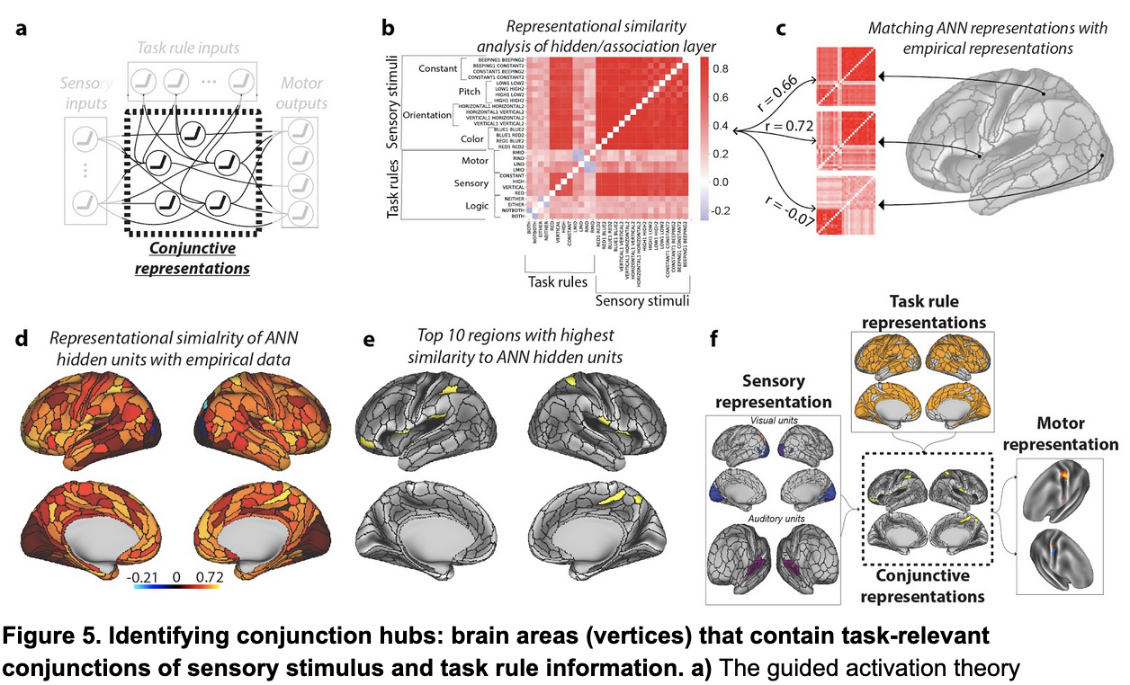
Identifying task-relevant brain areas: hidden/conjunctive regions

Slide 79
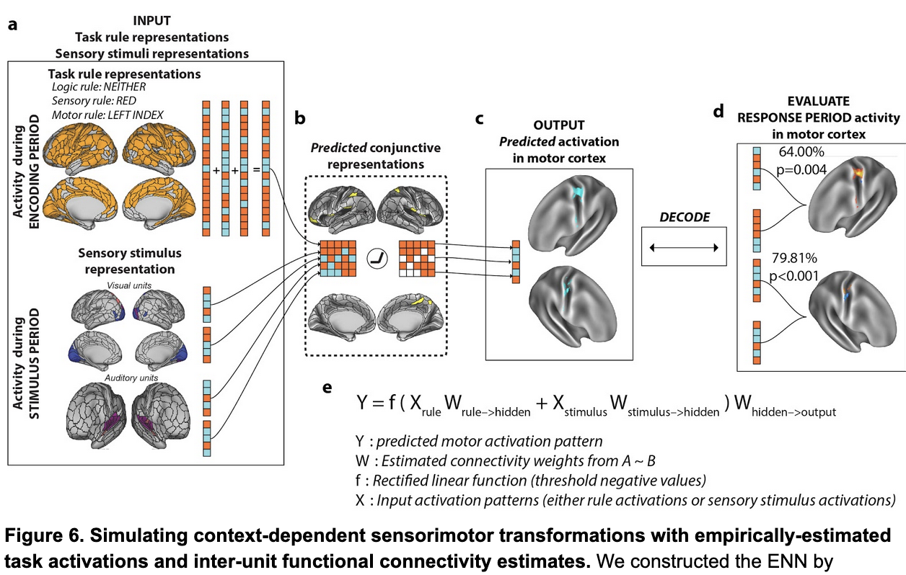
Simulating neural network computations using fMRI brain data

Slide 80
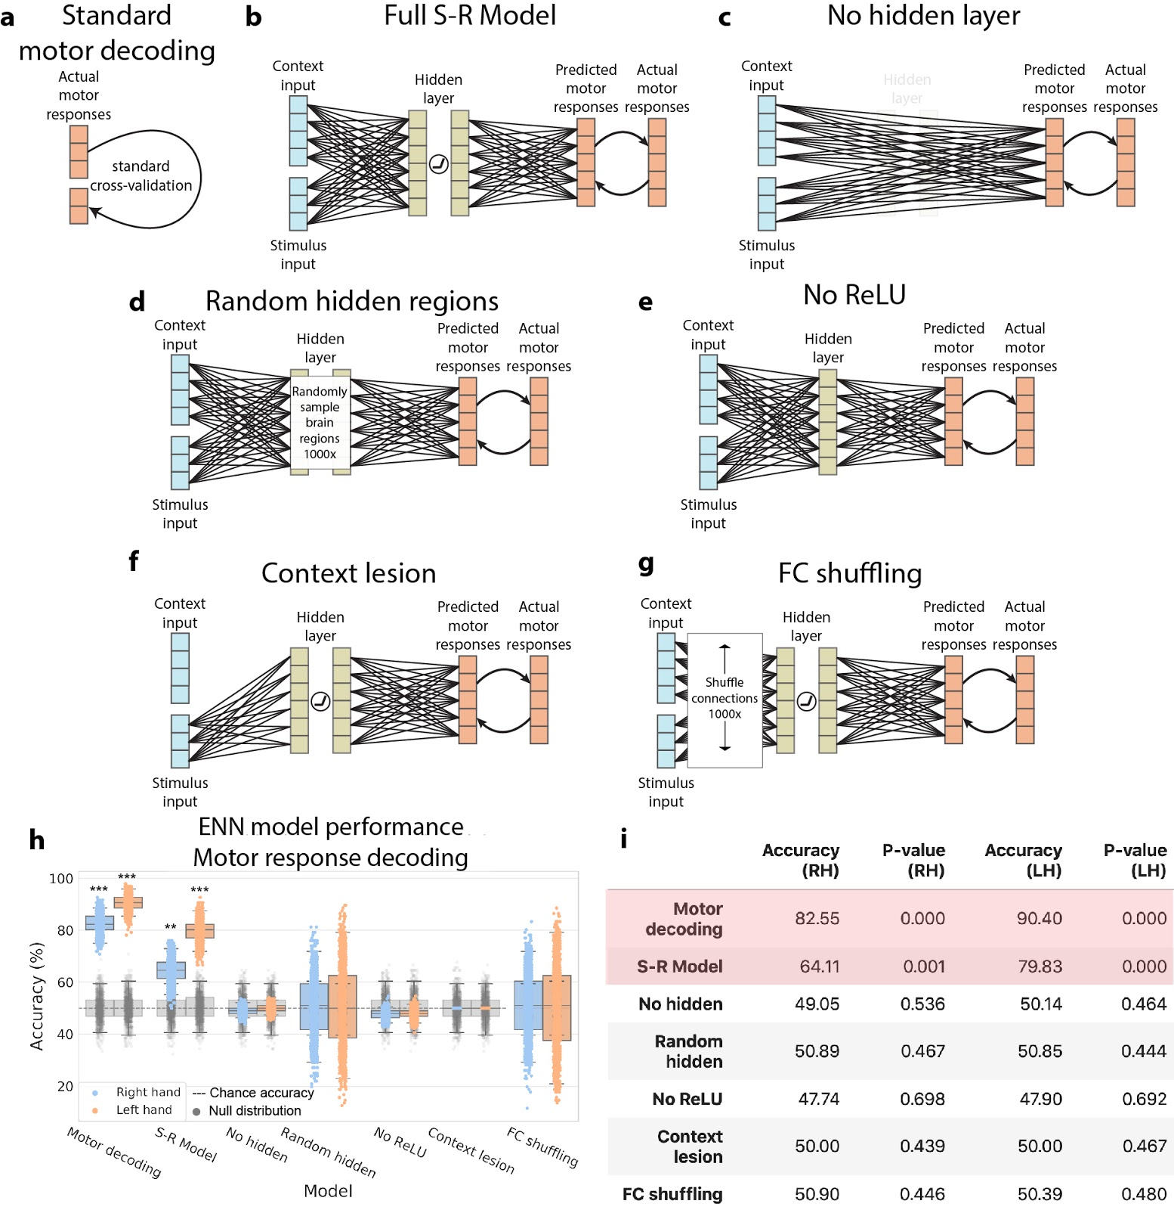
Systematic alteration of ENN model architecture verifies validity of “full S-R model” results

Slide 81
Systematic alteration of ENN model architecture verifies validity of “full S-R model” results

